Slide 1
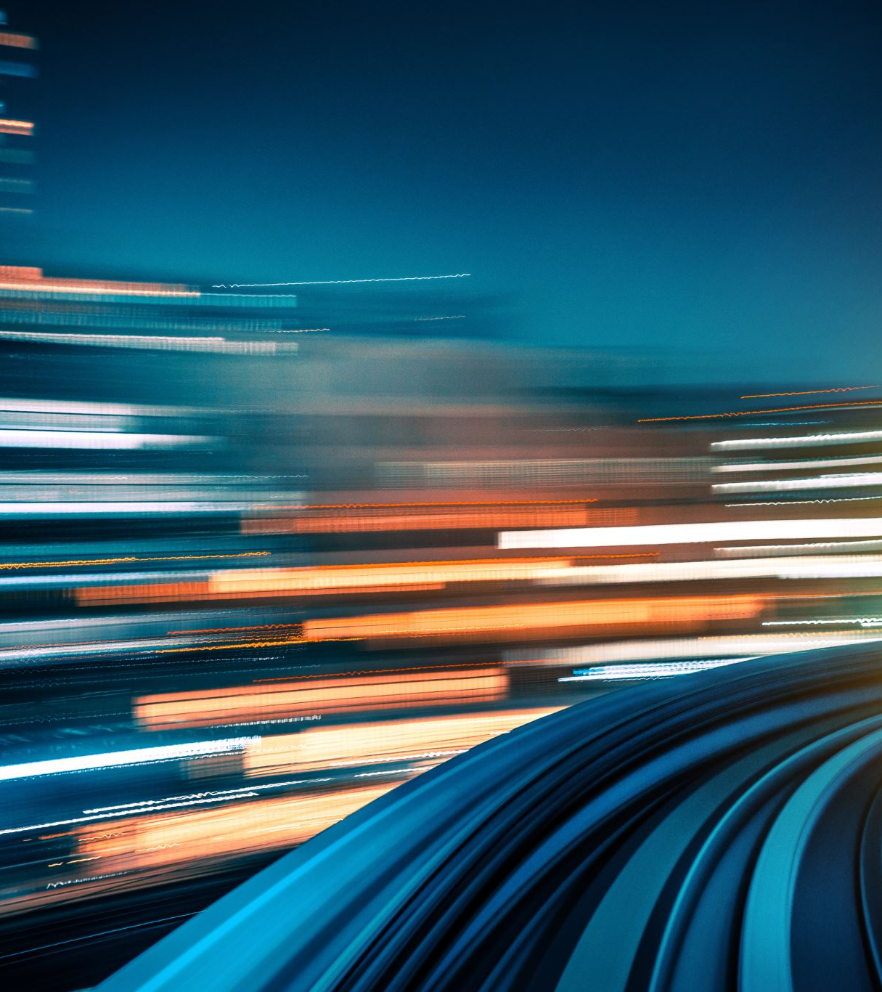
AI-Driven Autonomous Car
By: Anjan Kumar Gundinapalya Jayaramaiah
Instructor: Bahman Zohuri
Course: MSBA 326 Machine Learning for Predictive Analytics
Golden Gate University - Fall 2023

Slide 2
Introduction
Welcome to the presentation on AI-Driven Autonomous Car It built using Raspberry pi, Python, and Deep Neural Networks.
The goal is to implement a model of real-world applications of AI in autonomous vehicles. It cover data collection, model training, results, and apply model in hardware.

Slide 3
Components Overview
Toolbox includes:
Python and Keras: These powerful tools for deep learning allow us to develop and train AI models for tasks such as object detection, path planning, and decision-making.
Raspberry pi: The Raspberry Pi is a small, affordable, and versatile single-board computer. Running on Linux-based operating systems like Raspberry Pi OS, it supports various tasks from basic computing to complex projects like home automation and robotics. Its GPIO pins enable easy hardware interfacing, making it popular for learning electronics and programming.

Slide 4
Vehicle & Vision Sensors
Vision sensors, including cameras, LiDAR, and radar, serve as the 'eyes' of autonomous cars, enabling them to perceive the environment, detect obstacles, and make critical decisions. Cameras provide visual data for tasks like lane detection. These sensors, in conjunction with AI algorithms, empower autonomous vehicles to navigate safely and make informed decisions.

Slide 5
Setup
Raspberry Pi Environment:
Setting up a Raspberry Pi with a 4-wheel car using an H-bridge motor driver board involves assembling the car chassis, connecting the motors to the H-bridge, linking the H-bridge to the Raspberry Pi for motor control, ensuring a suitable power supply
Car Model:
We select a realistic car model, complete with sensors and actuators, to represent the autonomous vehicle.
The car model is integrated into the driving environment, allowing it to interact with the surroundings.
Vision Sensors Integration:
Vision sensors, such as cameras, are strategically positioned on the car model.
These sensors replicate the perception capabilities of real autonomous cars.
Scripting and Control
We use python scripting to program the car’s behavior to operate in real-world conditions.
This includes setting up path planning, decision-making, and control algorithms.
Data Recording/Collecting:
As the car runs, we record data from the vision sensors and the car's responses.
This data becomes valuable for training and evaluating our AI models.

Slide 6
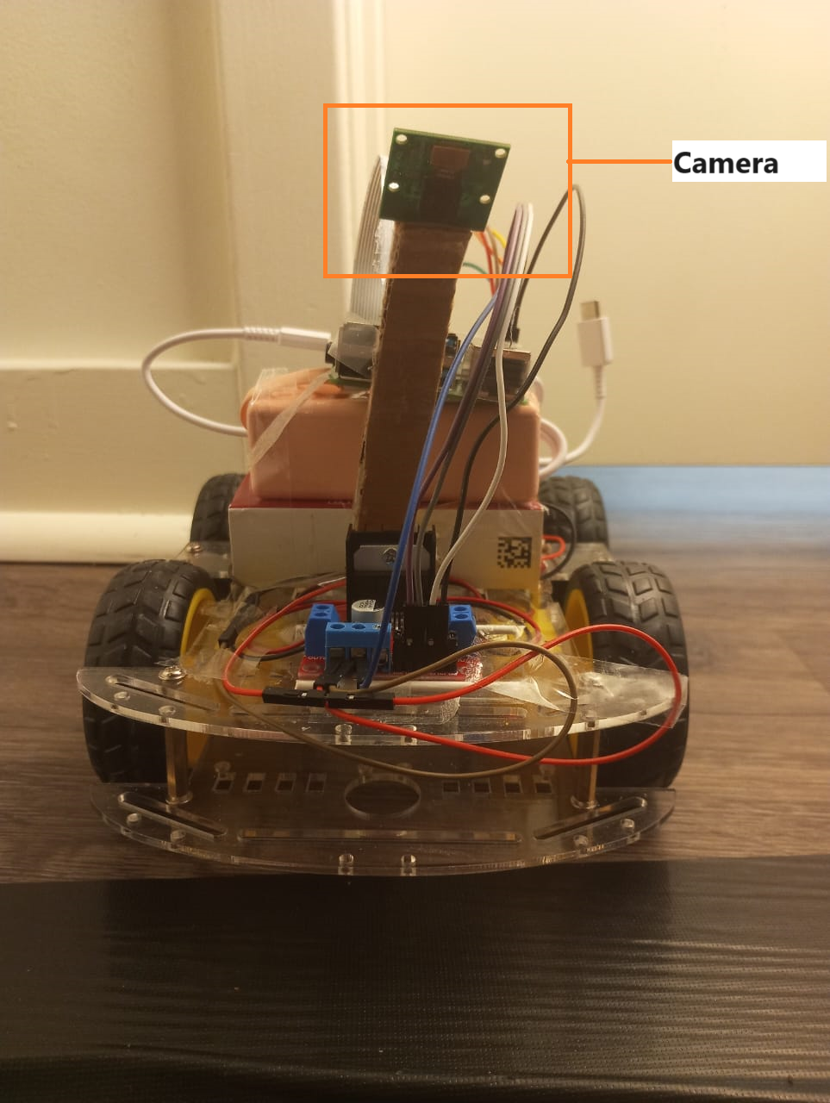
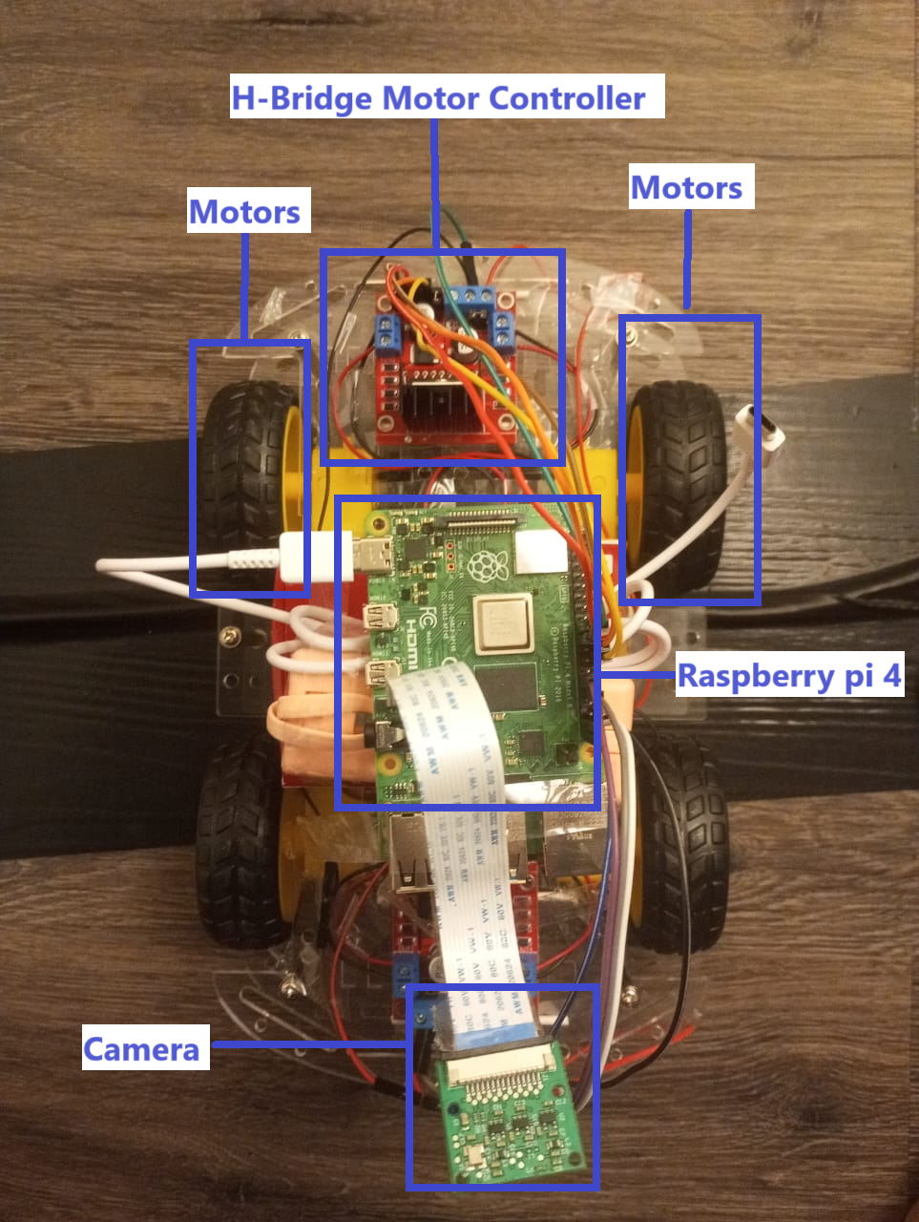
CAR Setup

Slide 7
Data Collection
"In this project, data collection from vision sensors is a critical step. It's this data that empowers our AI models to learn and make informed decisions. Here's how we gather insights from our vision sensors:
Camera Data:
Cameras capture images of the environment as the car navigates in the environment.
These images serve as raw input for various computer vision tasks, such as object detection, and lane tracking,.

Slide 8
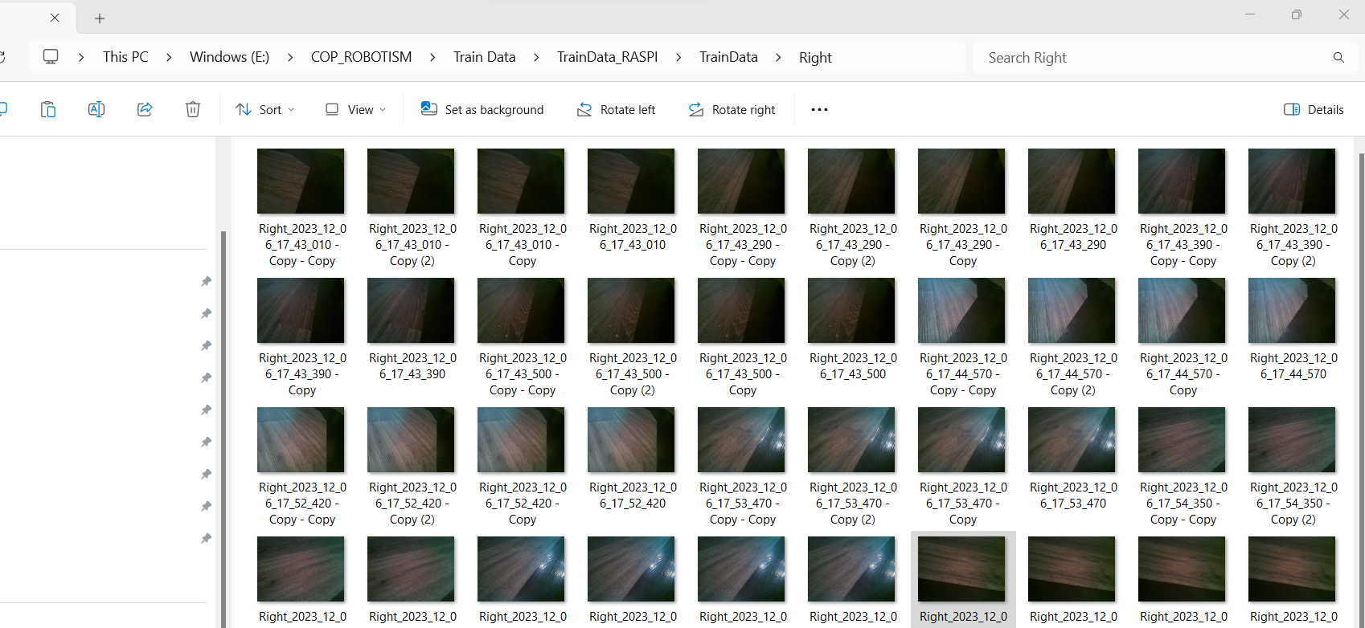
Data Collection- Right

Slide 9
Data Collection- Left

Slide 10
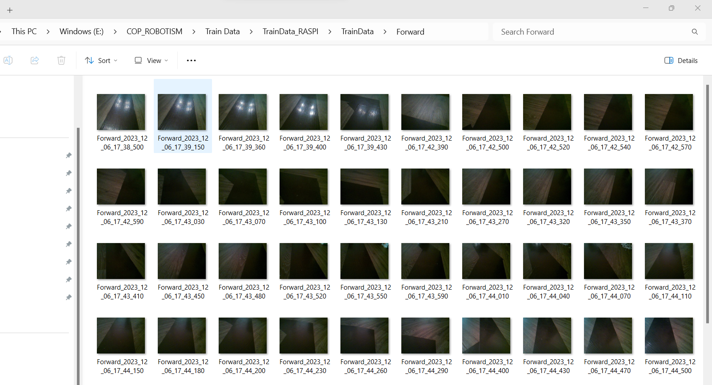
Data Collection- Forward

Slide 11
Deep Learning Model
"In our project, deep learning serves as the brain of our AI-driven autonomous car. This section focuses on the core component, the deep learning model:
Model Architecture:
Convolutional neural network (CNN) that takes input from the vision sensors.
The CNN architecture is optimized for tasks like object detection, lane tracking, and decision-making.
Training Data:
The model is trained on the data collected from our previous steps, including camera images, This data forms the basis for teaching the AI to recognize and respond to various scenarios.
Labeling:
Data is carefully labeled, indicating the presence and characteristics of objects, road markings, and more.
This labeling is essential for supervised learning, enabling the model to generalize from the provided examples.
Training Process:
We utilize Python and the CNN deep learning framework for training.
The model undergoes iterations of training to learn and improve its performance.
Inference and Decision-Making:
Once trained, the model can perform real-time inference on new sensor data.
It makes decisions about steering, acceleration, braking, and navigation based on its learned knowledge.

Slide 12
Model Training and Results
In the 'Training and Results' section, There will be a training process for our deep learning model and the outcomes it has produced. Which has the data split, training metrics, and validation process, which ensure our model's robust performance. The results we share demonstrate the model's ability to navigate, recognize objects, and make driving decisions within environment. The decisions include move Forward, Left and Right.

Slide 13
Applications OF Autonomous CARS
Autonomous Driving:
Self-driving cars promise safer and more efficient transportation.
They can navigate complex road conditions and reduce accidents caused by human error.
Delivery Services:
Autonomous cars are changing the landscape of last-mile delivery.
Companies are exploring driverless delivery vehicles for efficiency and convenience.
Ride-Sharing:
Ride-sharing platforms are integrating autonomous cars into their fleets, offering cost-effective and convenient transportation options.
Public Transportation:
Autonomous buses and shuttles are being tested in some cities, enhancing public transportation and reducing congestion.
Smart Cities:
Autonomous cars are a key component of smart city initiatives, reducing traffic, energy consumption, and pollution.

Slide 14
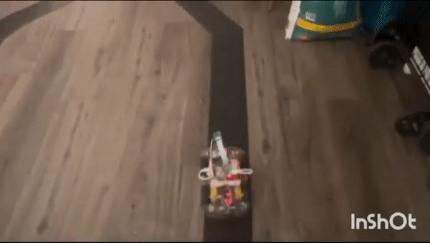
Outcome

Slide 15
Thank you

